Slide 1
DeepskyLog 5.0
What to expect

Slide 2
New Layout
Bootstrap
Responsive
Easy to use framework
TableSorter
Sorting
Movable columns

Slide 3
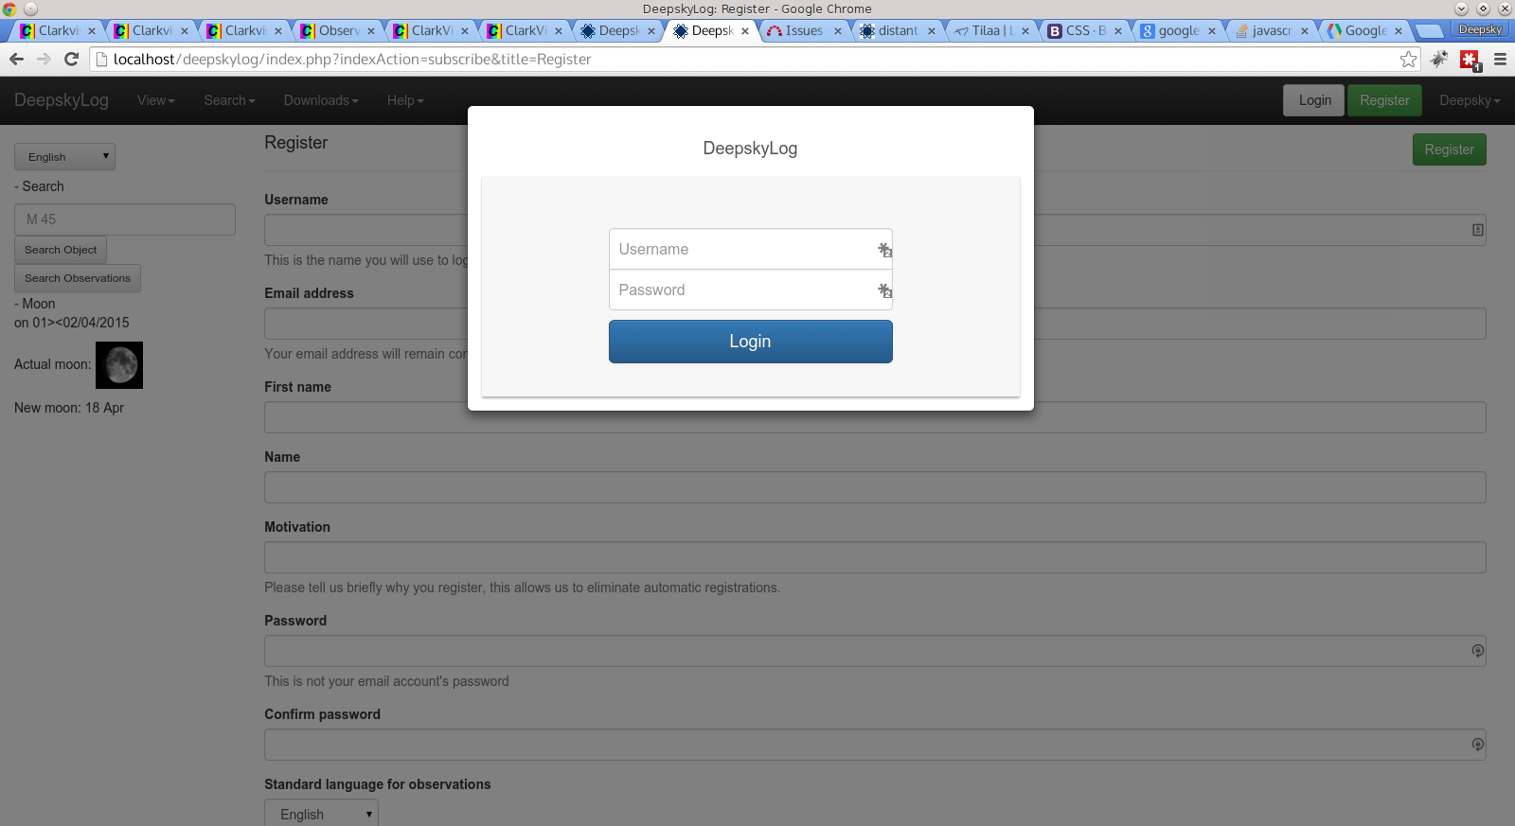

Slide 4
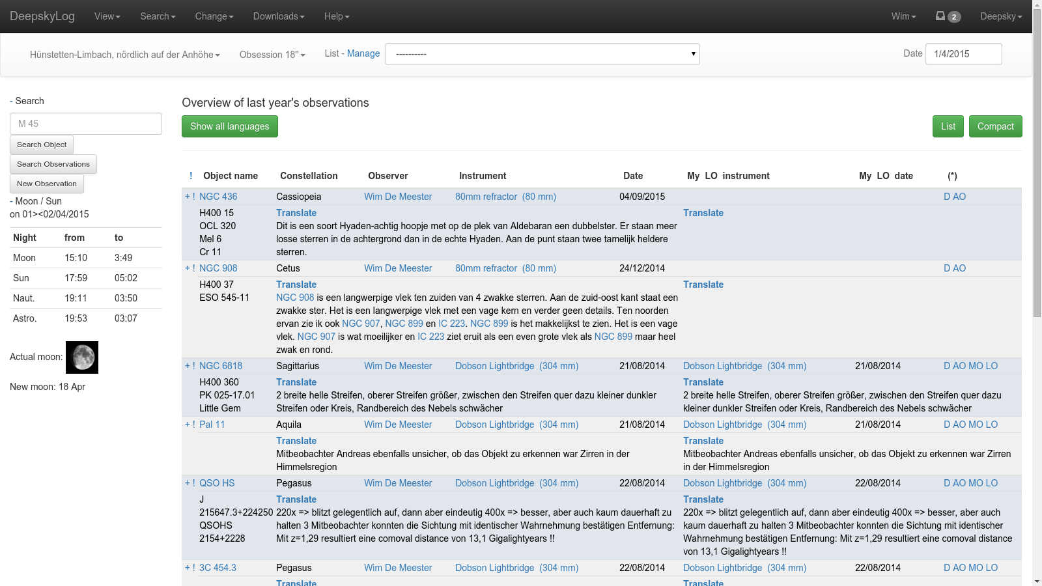

Slide 5
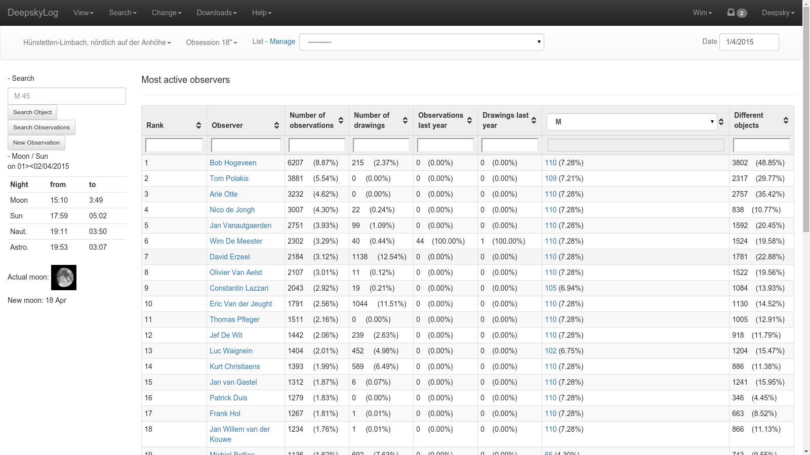

Slide 6
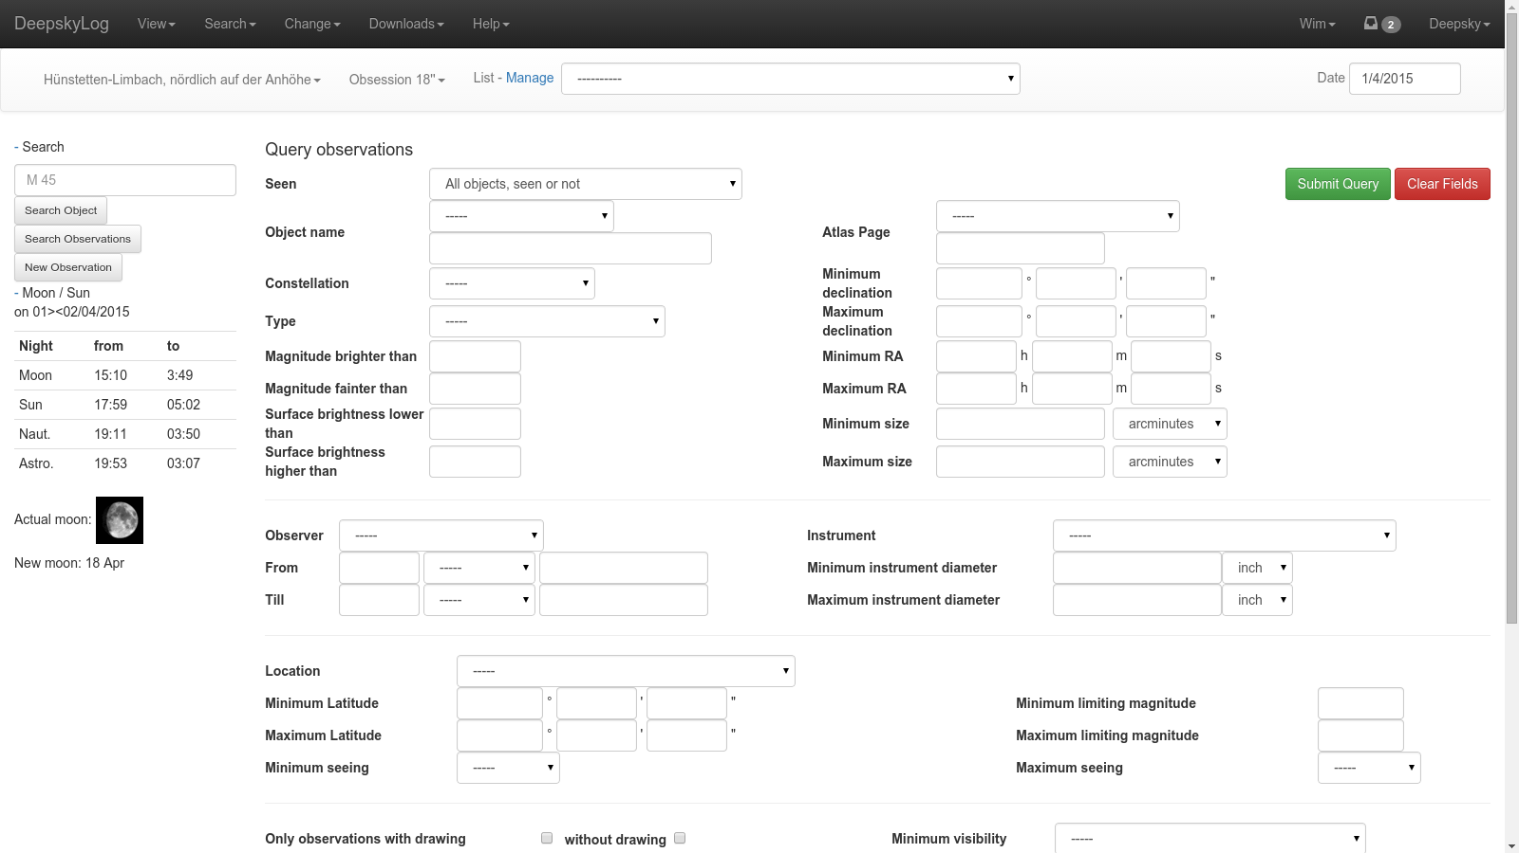

Slide 7
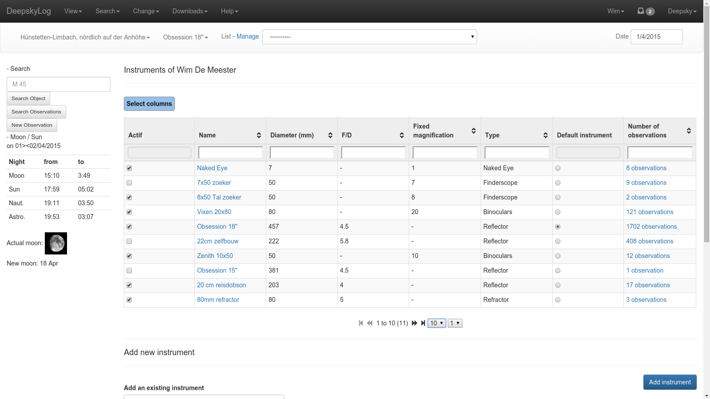

Slide 8
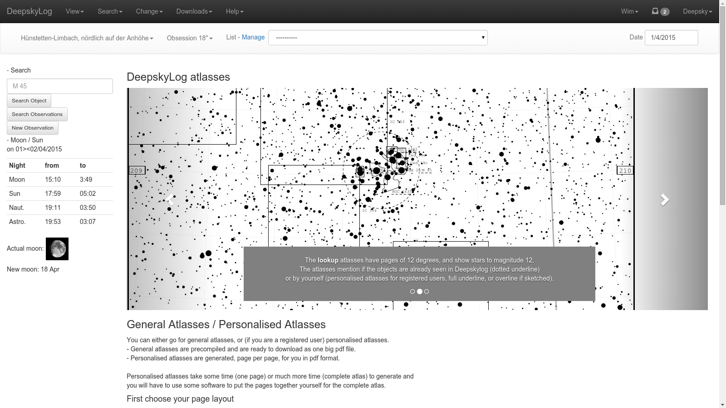

Slide 9
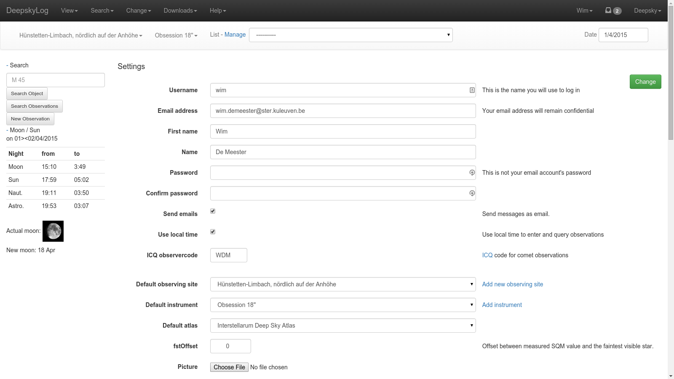

Slide 10
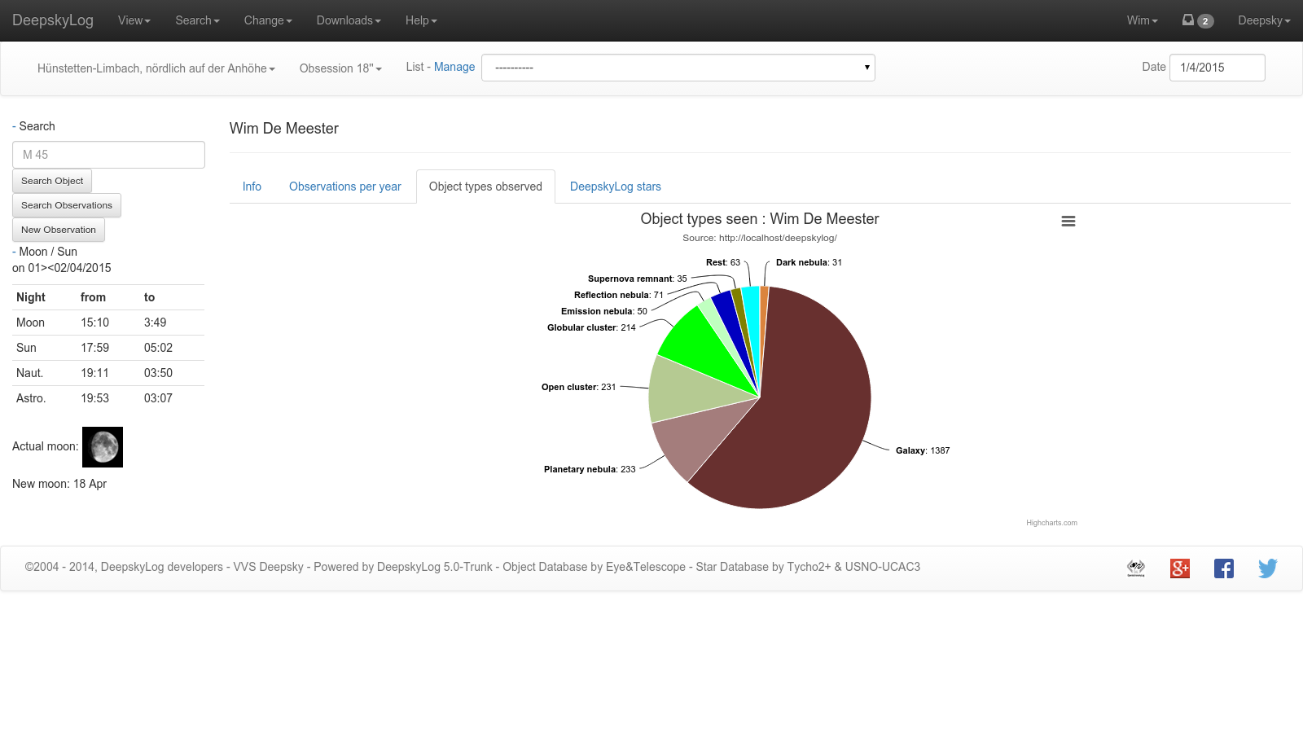

Slide 11
DeepskyLog Stars
Gamification

Slide 12
Use real emailaddress
Send message to real emailaddress

Slide 13
Picture of observers
in detail of observation and in messages.

Slide 14
New Logo

Slide 15
New entry page

Slide 16
Add locations

